Slide 1



Employee Spotlight
Presenter
Muthukumar

Slide 2
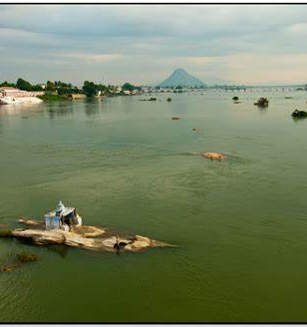
Introduction
Born and brought up erode, Tamil Nadu.
Completed Education MCA in 2006.
2

Slide 3
Carrier
3

Slide 4
Start Carrier as Junior developer in Coimbatore City Shifted as developer as Struts frame work in Chennai City. In the year 2009 moved to Bangalore for my carrier growth.

Slide 5
Joined Cignex Technologies 2010 December, Start working different clients Travelled Saudi Arabia for STC Project Joined AON in the Year 2014. Star working with Core team, AE team, YSA team different teams,
Travelled USA in the year 2015. for few months. Travelled back to India Joined AON Gurugram office for YSA project. And worked few months Noida.

Slide 6

Family
Father worked in the Police Department,
Mother worked as Village Administrator
Brother is working in Dubai
My Wife is working in TCS Bangalore
6

Slide 7
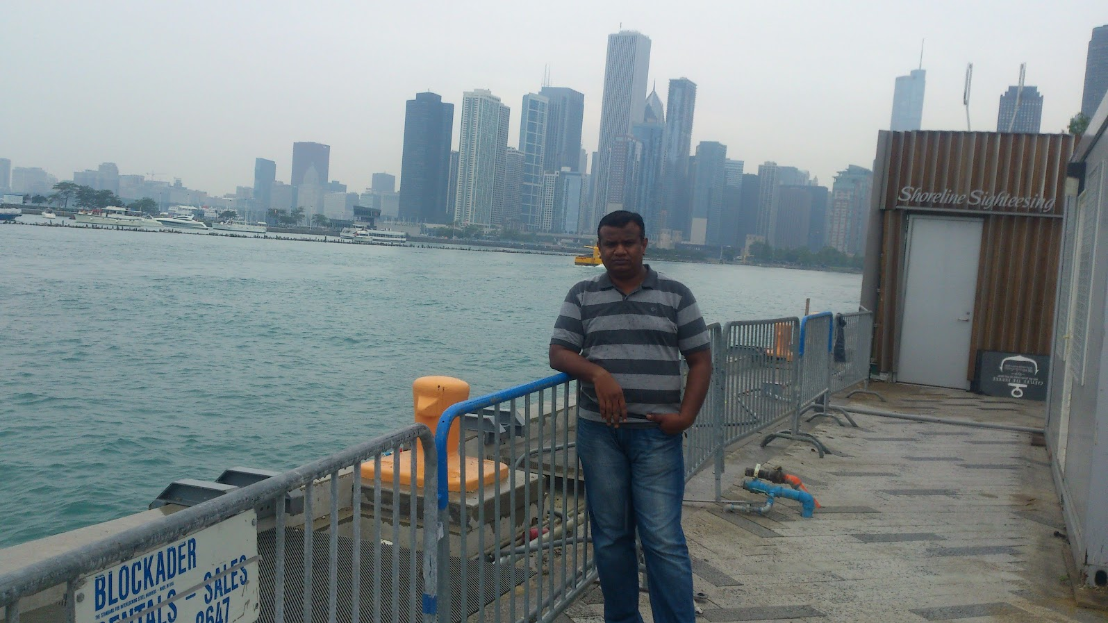
Travel
7

Slide 8
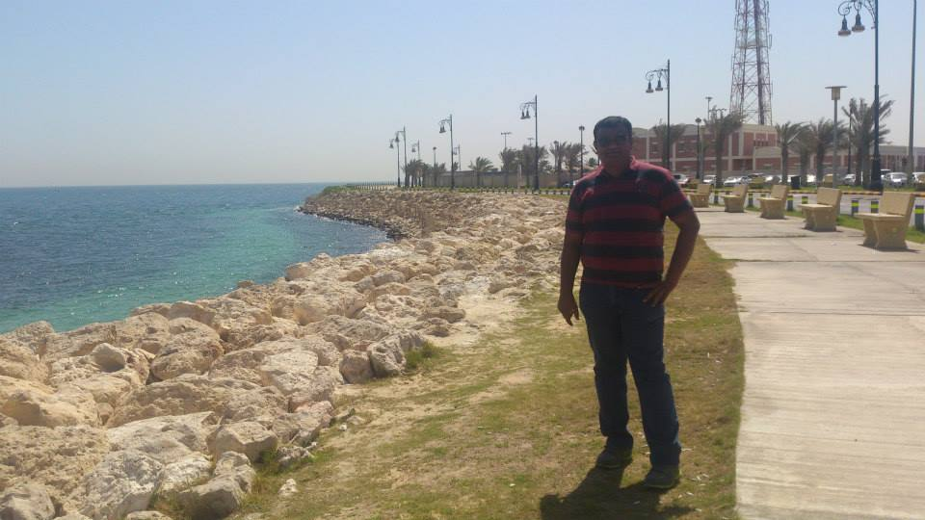
Travel
8

Slide 9
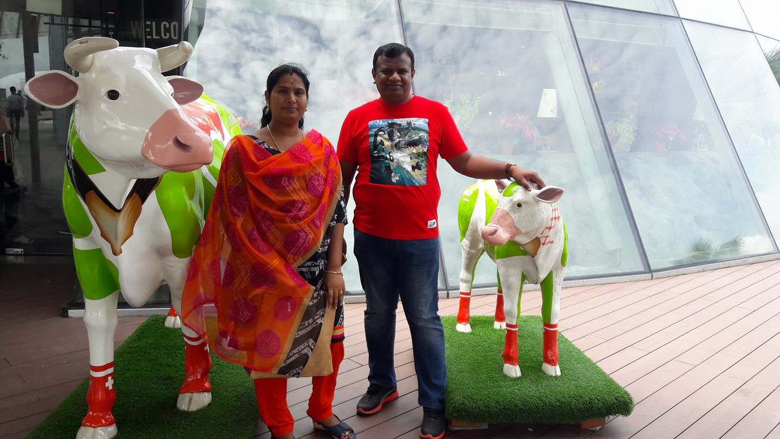
Travel
9

Slide 10
10

Slide 11
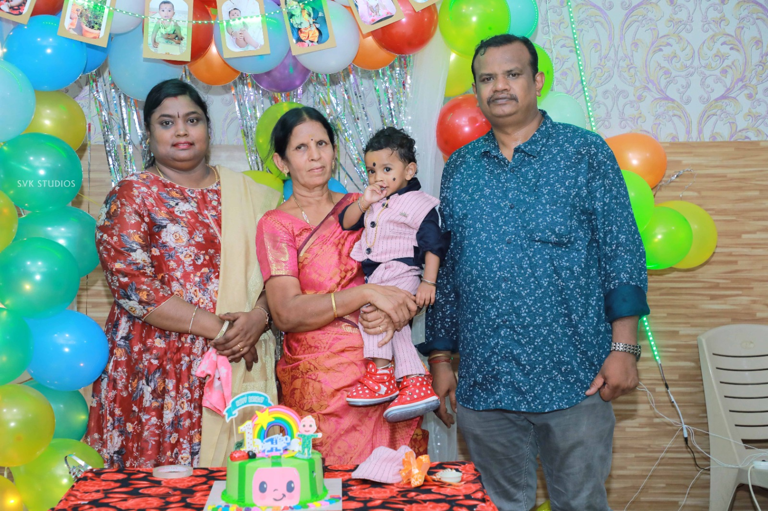
11

Slide 12



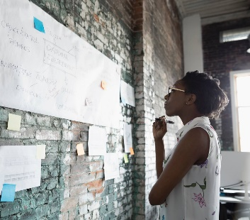
Thank you

